Slide 1
Self Driving RC Car
Ethan Wells
Abigail Duran
Ethan Bishop
Alexis Perez

Slide 2
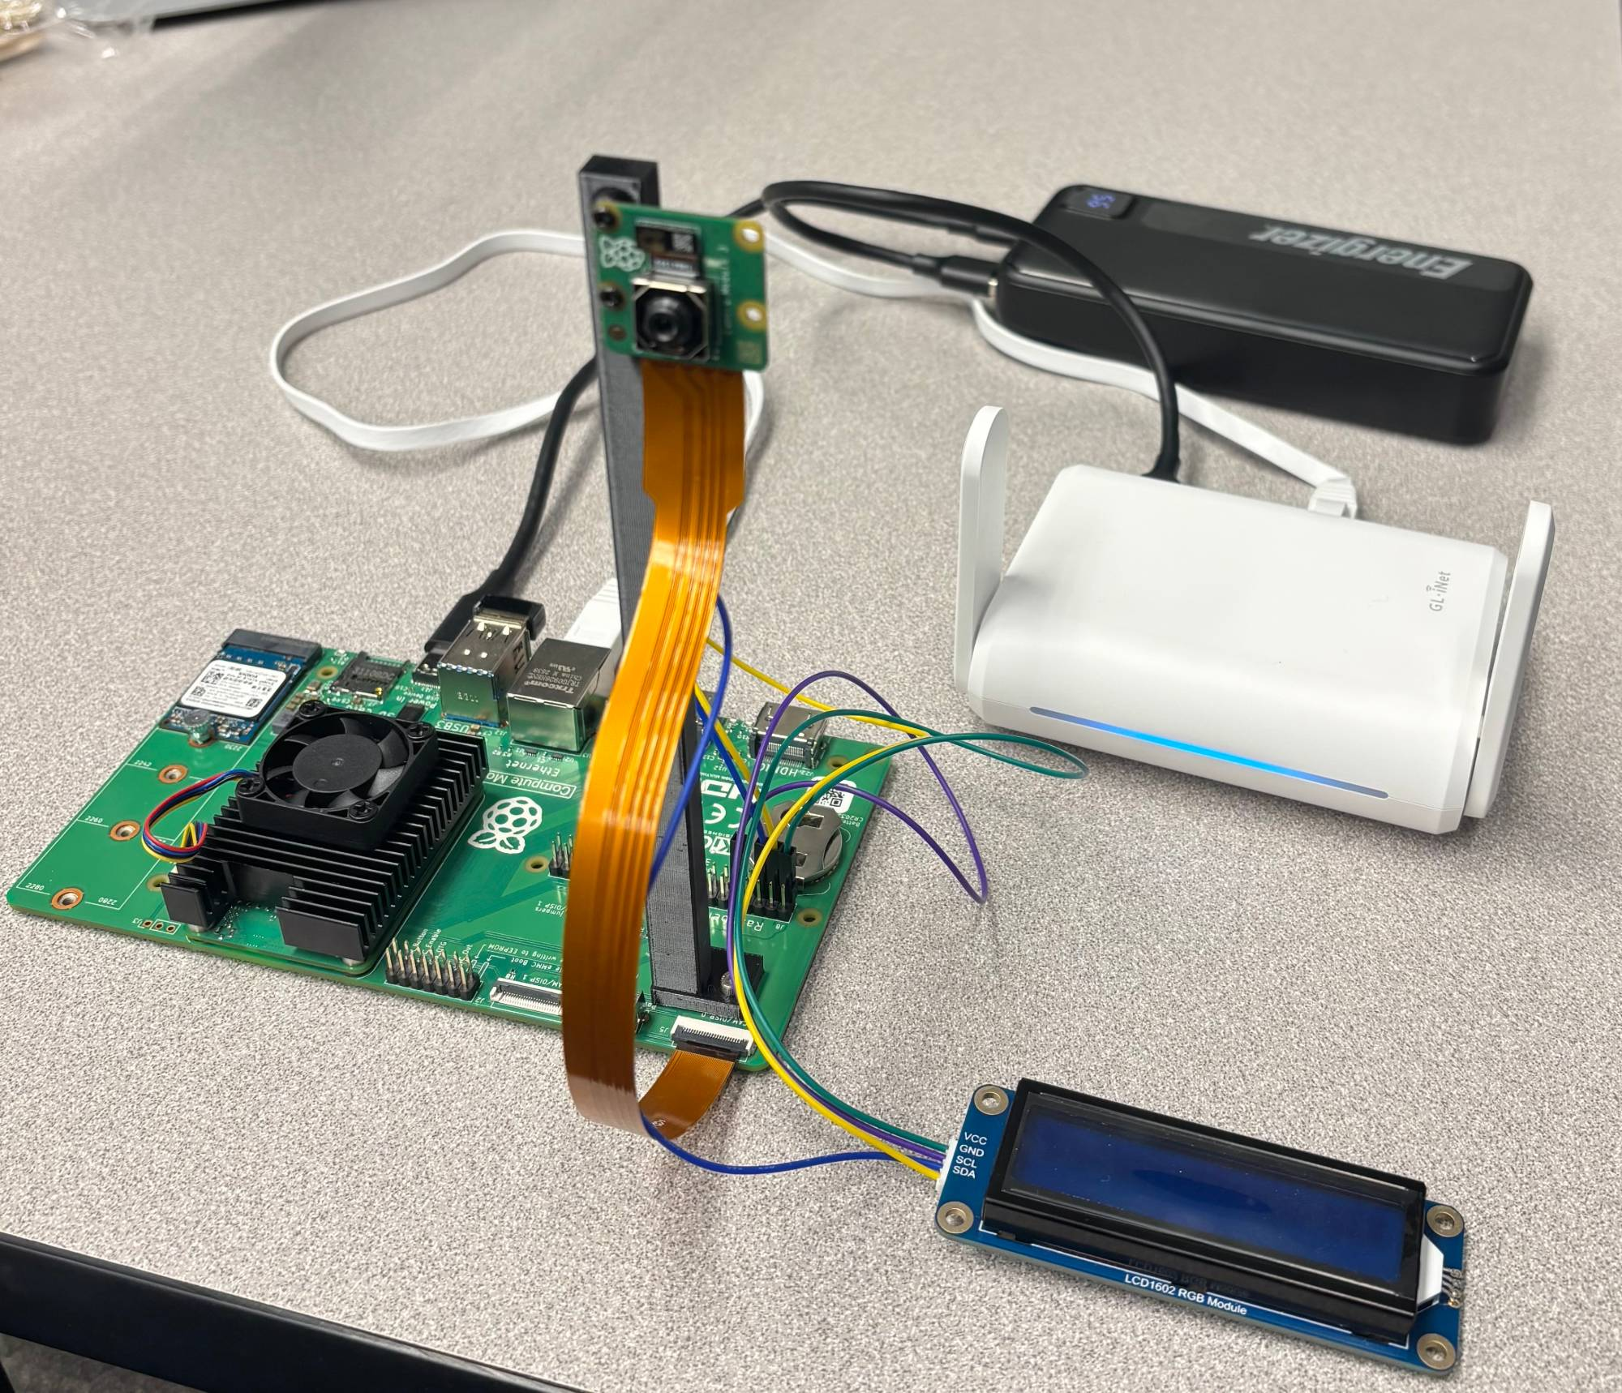
System Overview
Goal
  Semester 1: recognize US traffic signs on the car's own hardware
  Semester 2: drive a course and obey the signs
Hardware
  Raspberry Pi CM5 on the CM5 IO Board
  Camera Module 3, LCD, IMU, line sensors, motor HAT
Software
  OpenCV finds sign-like regions
  A TensorFlow model I trained classifies them
  The result is shown on the LCD
Demo setup: CM5, Camera Module 3, LCD, battery, and travel router
Pi Camera
OpenCV
Sign model
LCD
Ethan Wells

Slide 3
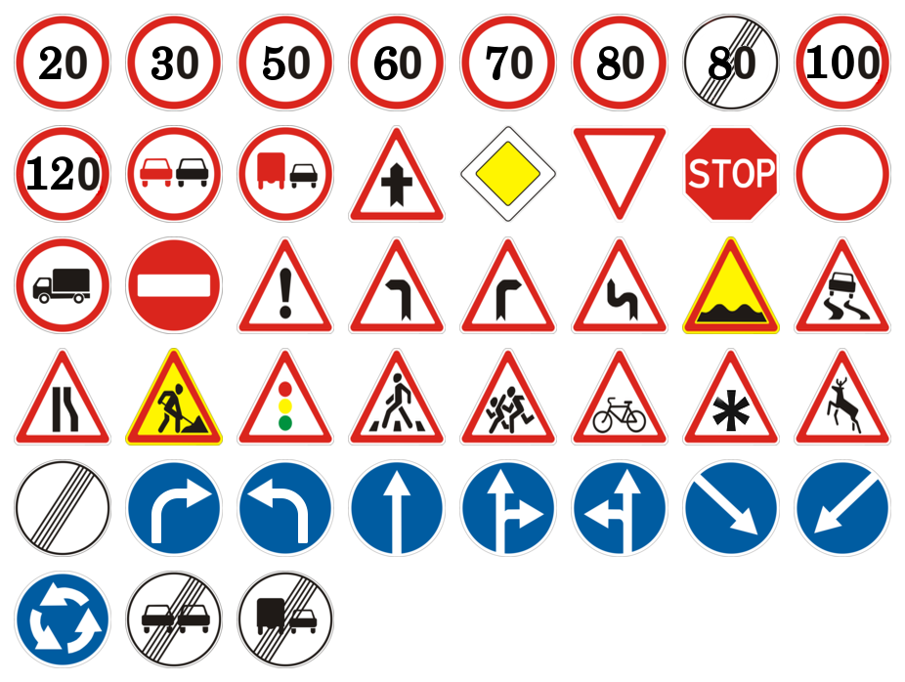
Proving the Method on GTSRB
The dataset: GTSRB
  German Traffic Sign Recognition Benchmark (Ruhr University Bochum), via Kaggle
  51,839 images of 43 classes: 39,209 training, 12,630 test
Why start here
  Large and clean; no US dataset of that quality existed
What I built
  TensorFlow CNN on 32×32 crops, validation split by physical sign
Result
  95.79% top-1: 12,098 of 12,630 test images correct
What it proved
  The pipeline works with good data; the US problem was the data
The 43 GTSRB sign classes
Ethan Wells

Slide 4
Moving to US Signs
Top-1 accuracy by test set
Three models, 12 US sign classes
  LISA (UC San Diego, US road video): 6,097 crops
  Mapillary Traffic Sign Dataset (street-level photos): 3,449 crops
  Combined: 9,546 crops, 10.6% held out as 1,016 test crops
Test 1: the datasets' own test set
  The same 1,016 held-out crops for all three models
Test 2: BuggyBot's camera
  329 photos of our printed sign cards, three lighting conditions
  Sign crops placed by hand
Result
  Only the combined model held up on both tests
Ethan Wells

Slide 5
Sign Detection on the Pi
Camera frame
1280×720
OpenCV candidates
color and edge masks
How it works
  OpenCV proposes sign-shaped regions
  The model classifies each one: 1.9 ms per crop on the CM5
  Color and shape checks, then 3 matching frames in a row
The main problem: false positives
  The model has no "not a sign" class
  A pink shirt could read as a stop sign at 100%
Result
  Filters raised correct outputs from 79% to 86% to 100%
  Final test: 60 of 60 correct (10 signs, one room)
Sign model (LiteRT)
12 US classes
Shape and color check
reject impossible matches
3-frame confirmation
same sign 3 times in a row
LCD output
sign name and color
Ethan Wells

Slide 6
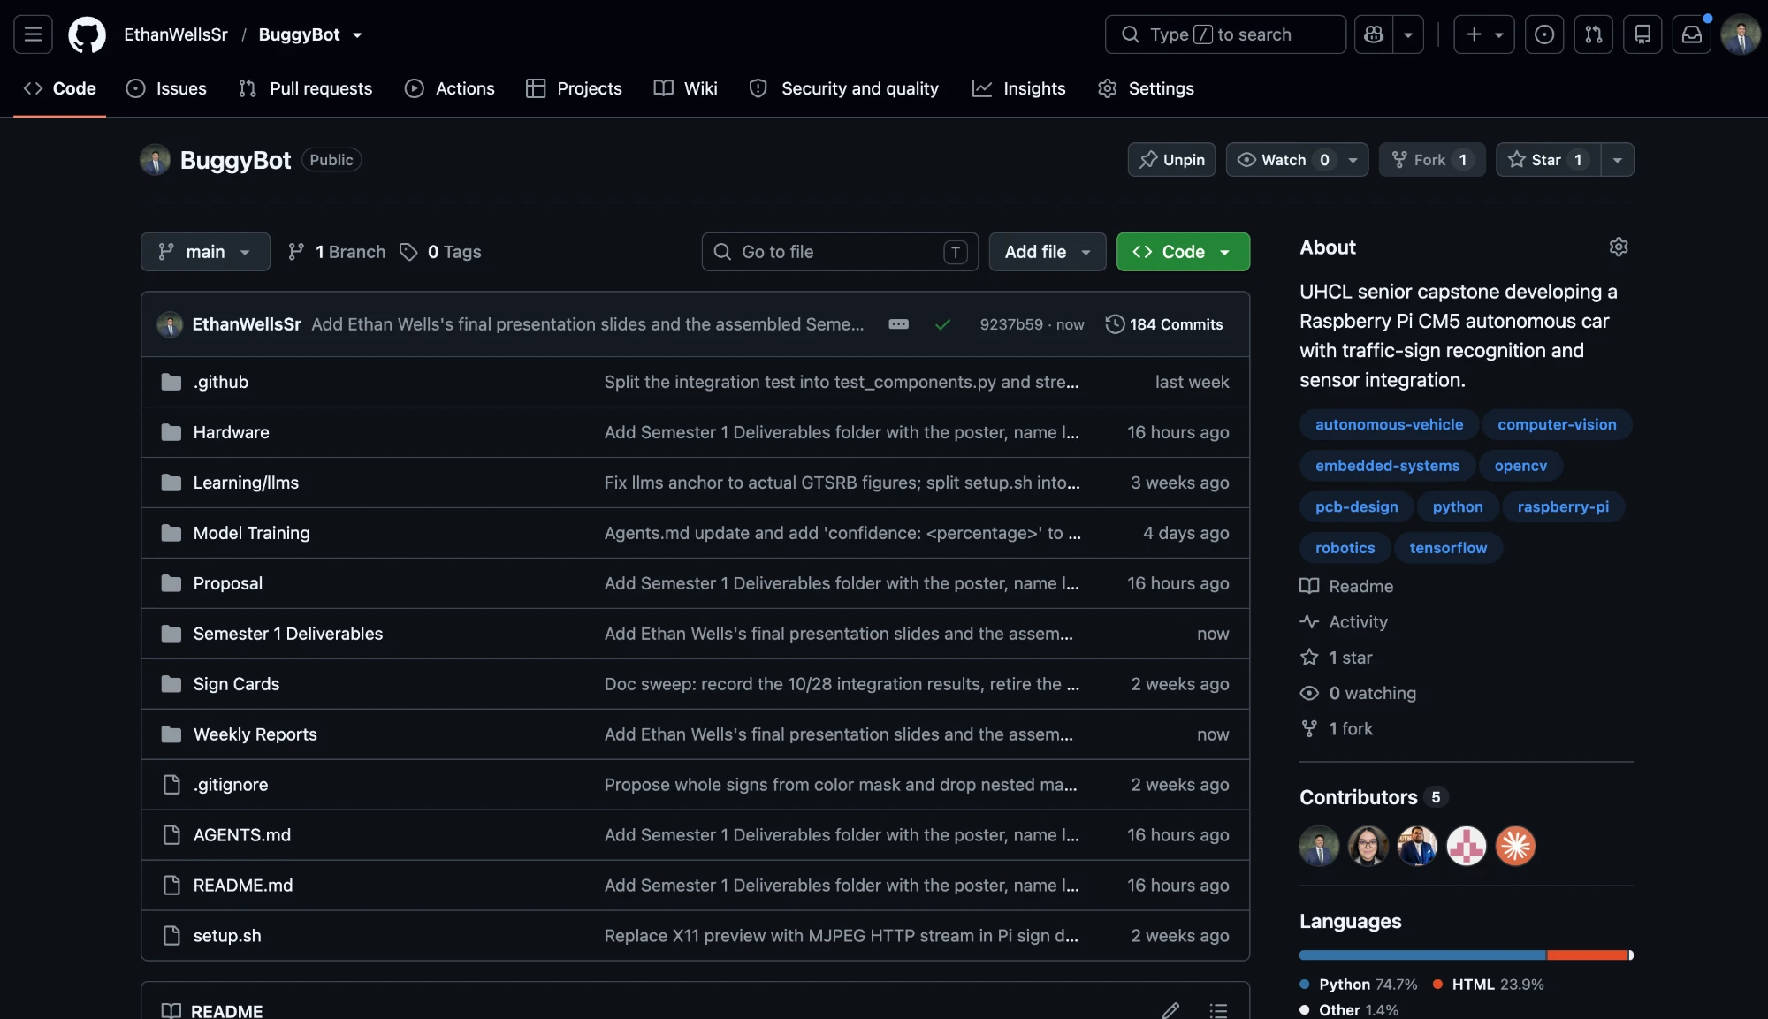
Project Management
GitHub repository
  Set up and managed the team repository all semester
  Code, models, test reports, schematics, and docs in one place
  184 commits since 9/08, with all four members contributing
Automated checks on every push
  Scripts compile and pass a bug lint
  Sign model re-checked on 329 camera photos
  Motor HAT pin maps and documentation links
Team workflow
  Weekly reports and slides built from the repository
  One slide file per person, so edits never conflict
github.com/EthanWellsSr/BuggyBot
Ethan Wells

Slide 7
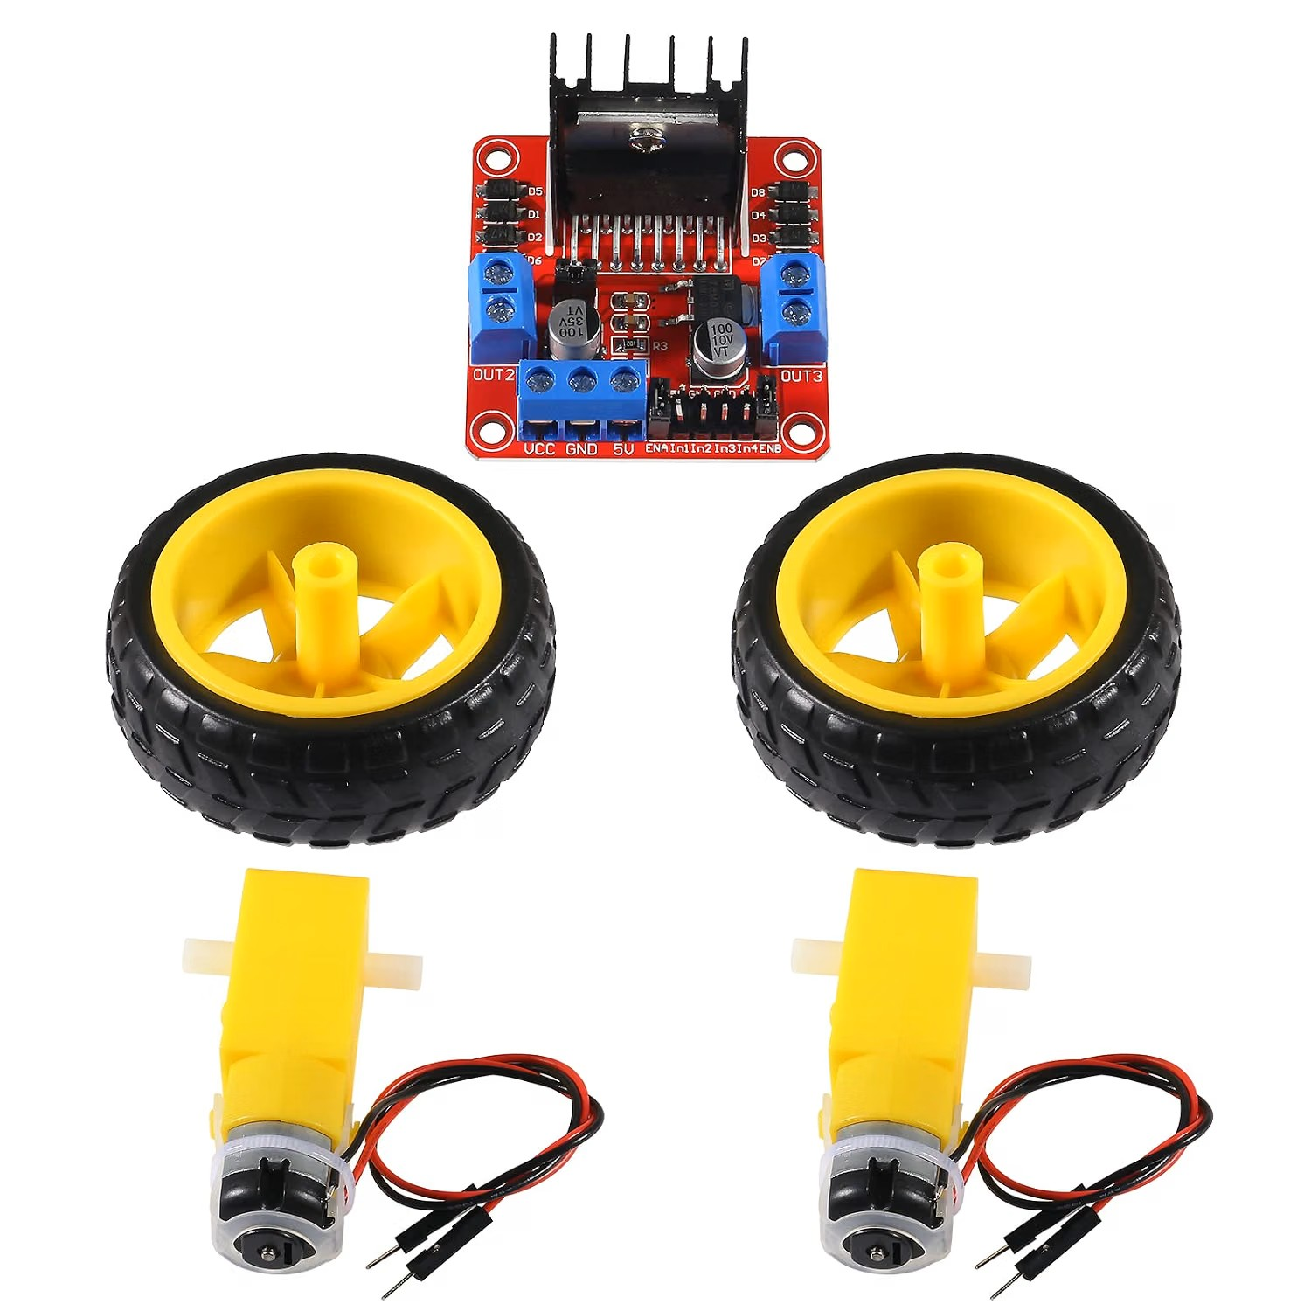
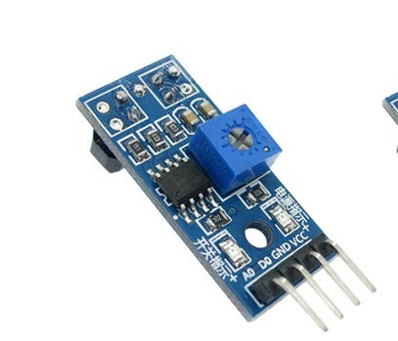
Hardware Research & Testing
Ultrasonic Sensors
  Researched obstacle detection capabilities
  Determined unnecessary for current project scope
Motors / Motor Controller
  Researched motor and controller compatibility
  Tested hardware and identified faulty controller
Line Sensors
  Researched options for lane navigation
  Planned implementation for Semester 2
Alexis Perez

Slide 8
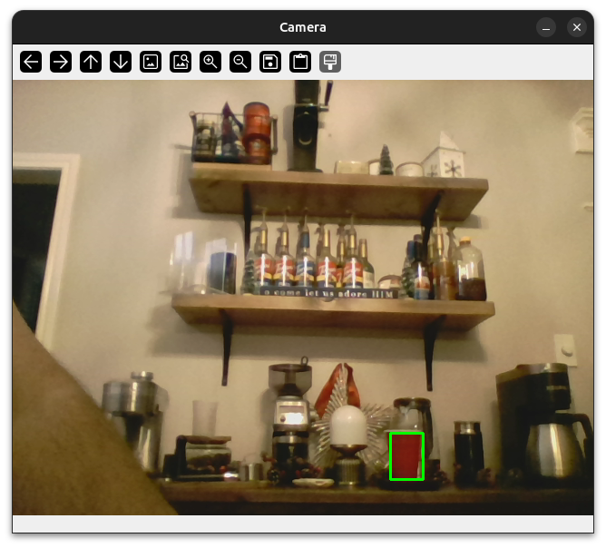
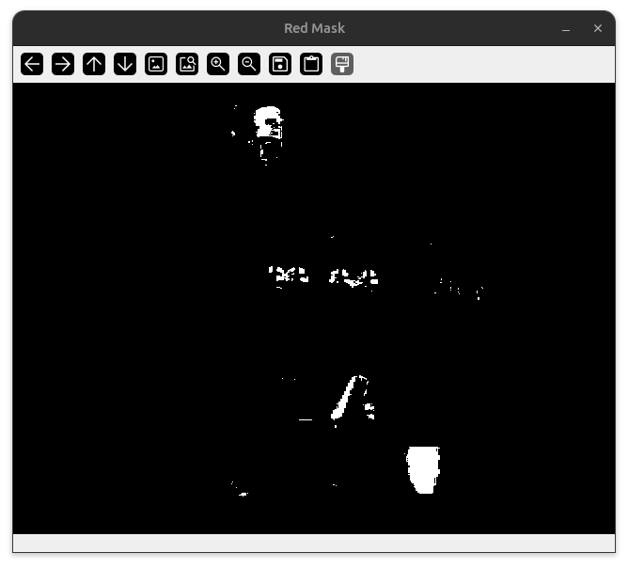
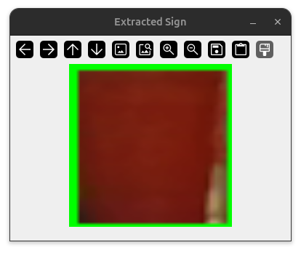
OpenCV Development
Independent Learning
  OpenCV tutorials
  Explored computer vision techniques
Test Scripts
  Developed Python scripts using OpenCV
  Practiced image processing and object detection
Alexis Perez

Slide 9
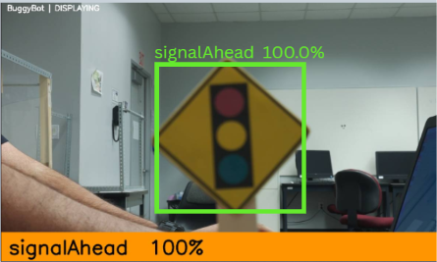
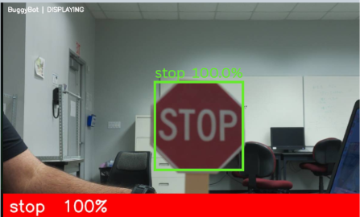
Sign Recognition Testing
Personal Machine Testing
  Tested trained vision model
  Verified sign detection using webcam
Raspberry Pi Testing
  Collaborated on Pi camera testing
  Evaluated recognition on target hardware
Observations
  Glare affected detection response
  False positives
Alexis Perez

Slide 10
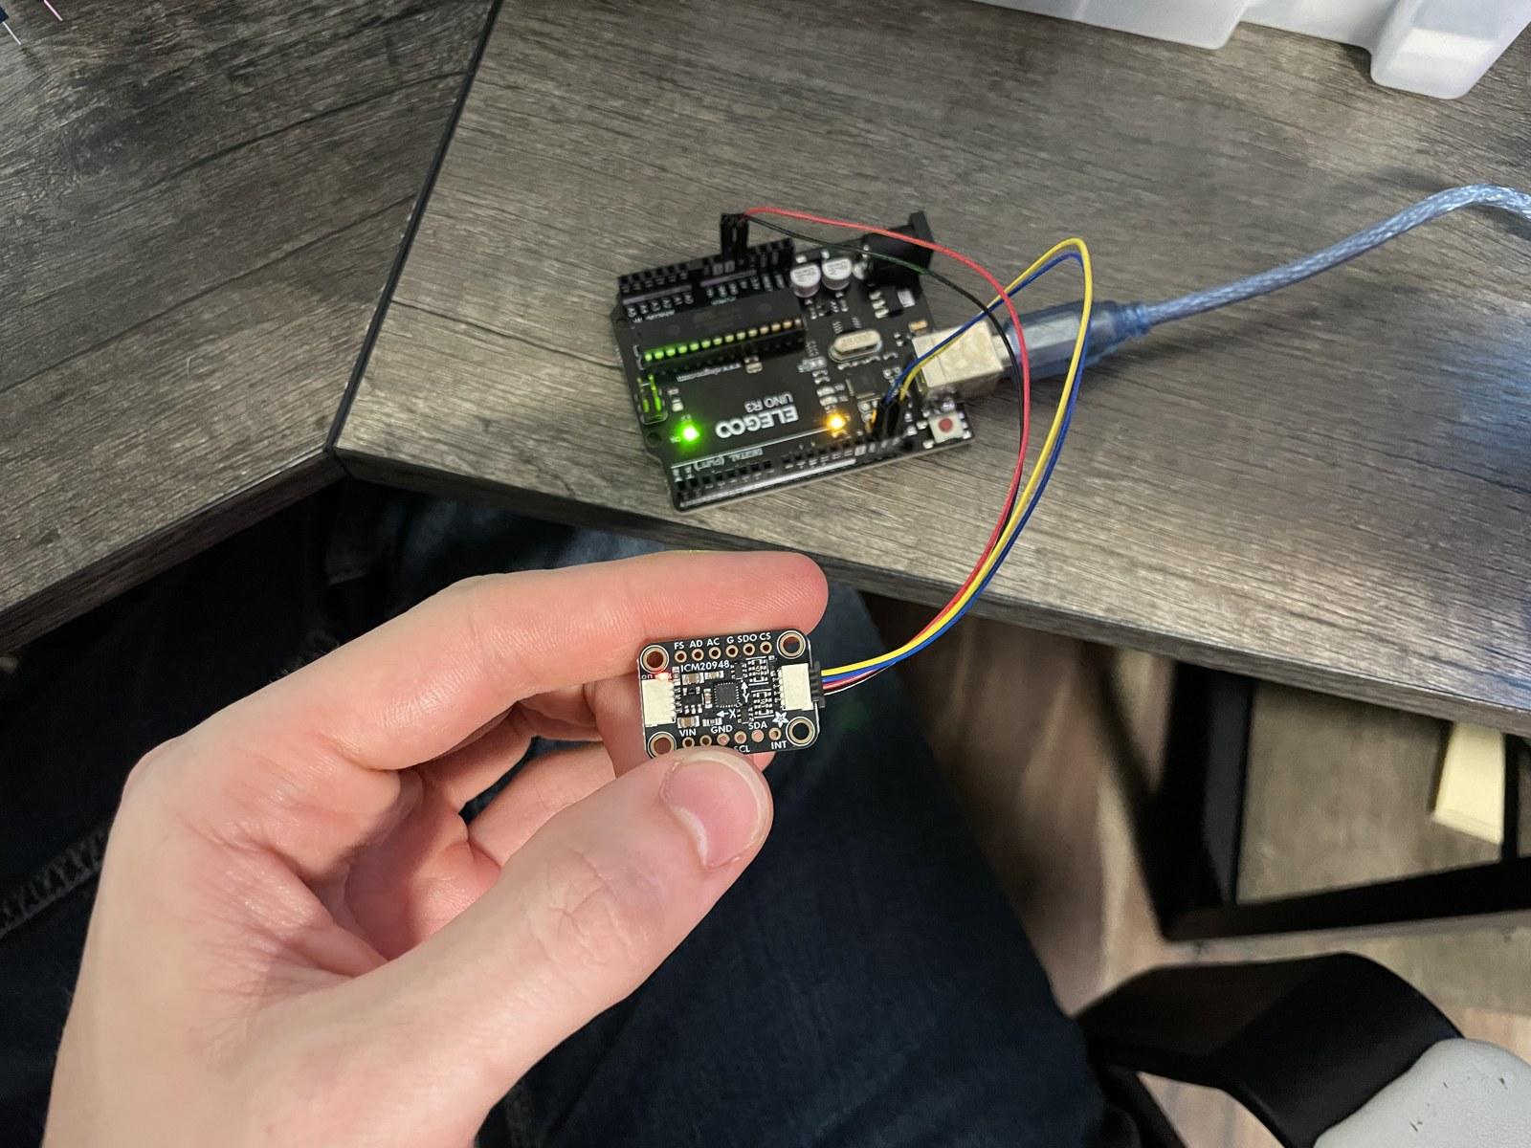
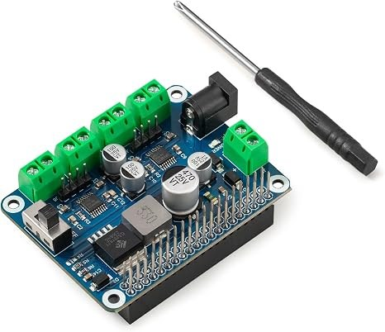
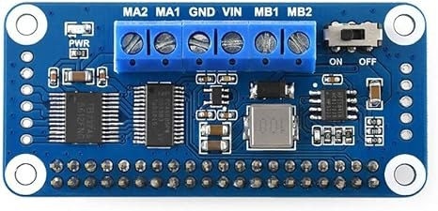
IMU & Motor Controller Testing
IMU (ICM-20948)
  Researched and ordered the IMU
  Wrote an IMU test script
  Verified measurements over I2C
Motor Controllers
  Researched controller options
  Ordered Waveshare 2WD and Cokoino 4WD HATs
  Wrote the first motor test script
  Tested both HATs on the Raspberry Pi
Ethan Bishop

Slide 11
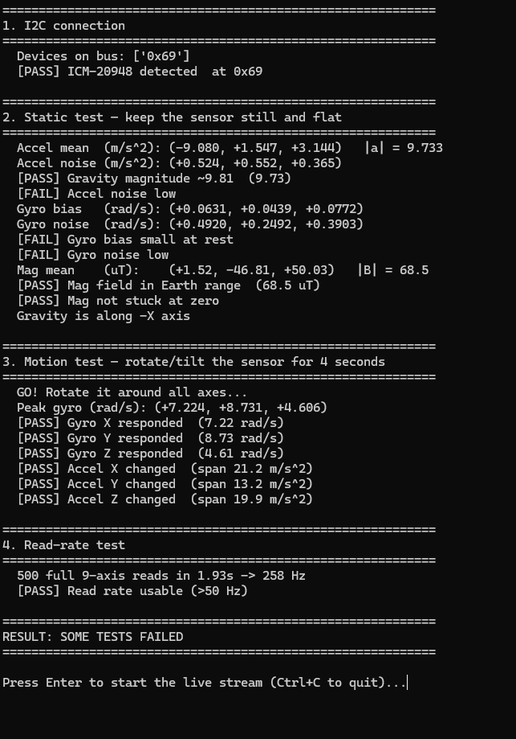
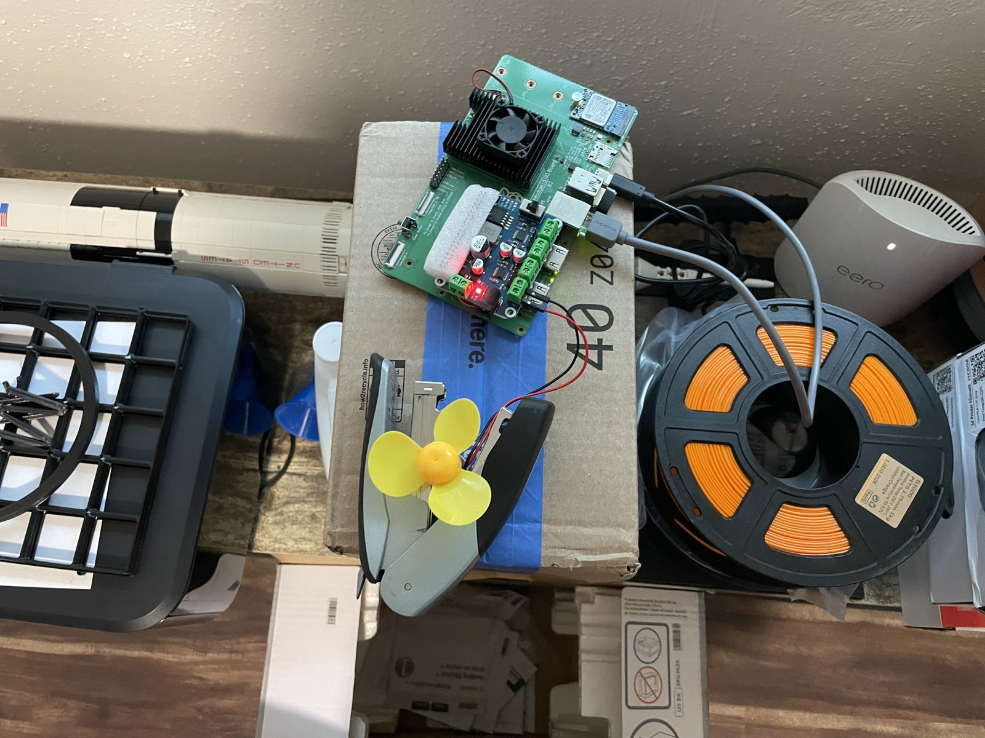
System Testing
Sensor Test Script
  Built one script for every sensor and the motors
  Line sensors, IMU, camera, LCD, motor HAT
  PASS / FAIL / SKIP summary
  Later split into component and stress tests
Stress Testing
  Helped stress test the full system
  Supplied the battery to make it mobile and a single unit
Ethan Bishop

Slide 12
Integration and Stress Testing
120 s stress test, 11/02
Measurement | Result
Camera frame rate | 30.0 fps (30.2 alone)
Under-voltage flags | None
I²C / sensor errors | 0
Motor reversals | 120
Line-sensor reads | 23,278
IMU reads | 9,361
LCD writes / signs shown | 235 / 22
CPU temperature | 38.9 → 42.8 °C
Two tests
  Component test: each device on its own
  Stress test: everything at once for 120 s
  Built from my original sensor script
Power
  The Cokoino motor HAT needs 7–12 V
  Tested on a 9 V bench supply, motors reversing at 60%
Result: PASS
  No errors, no under-voltage, no frame-rate drop
Ethan Bishop

Slide 13
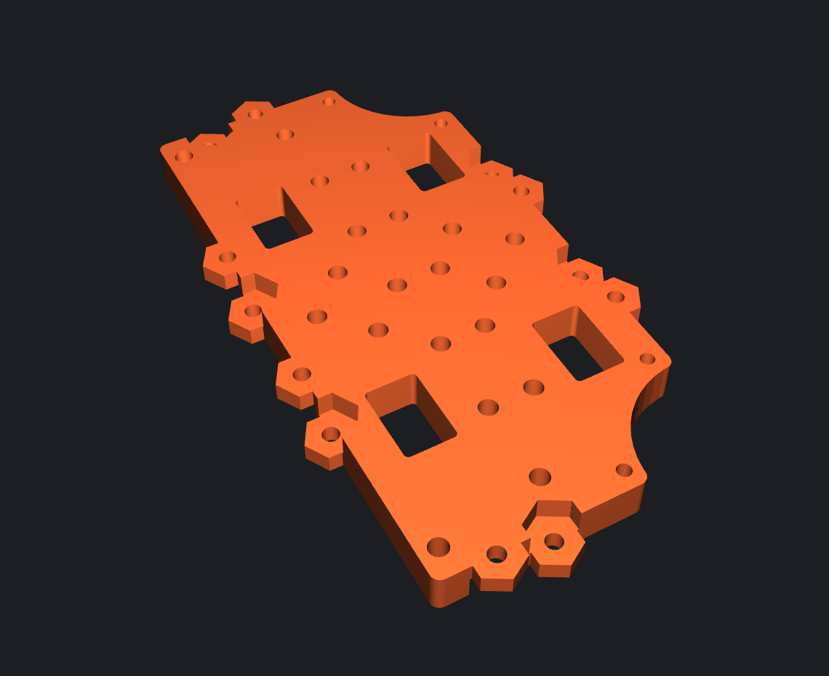
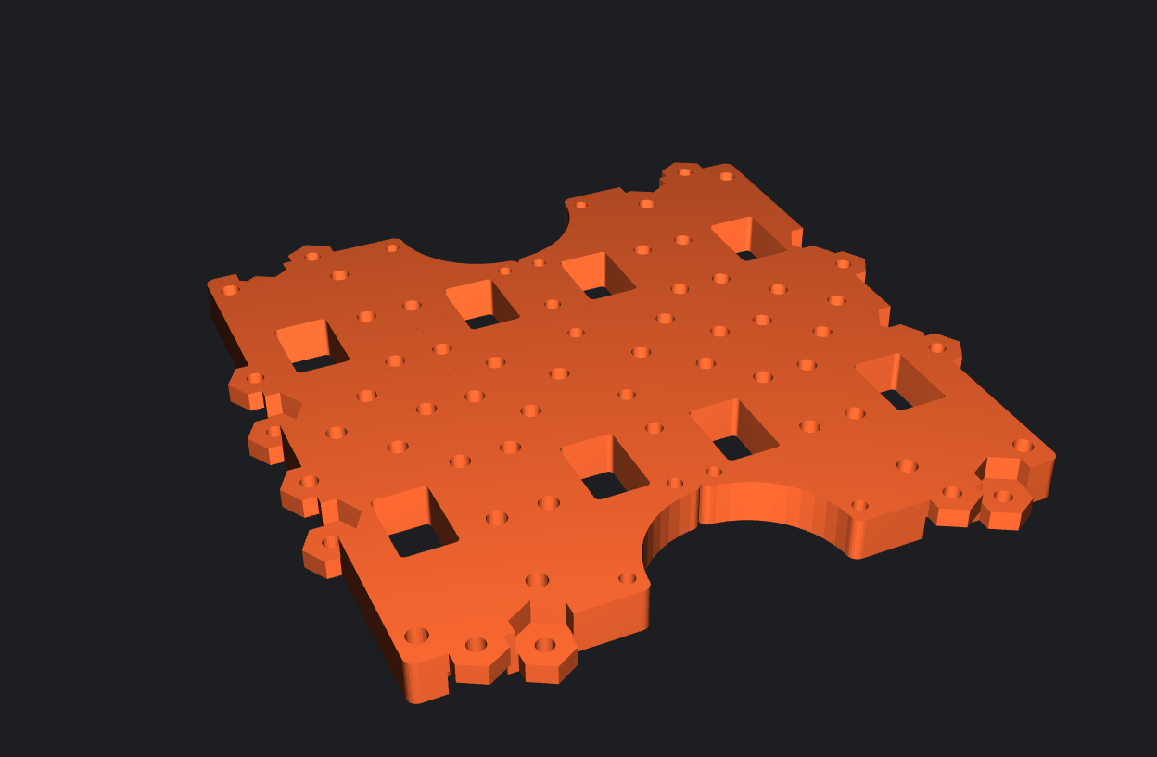
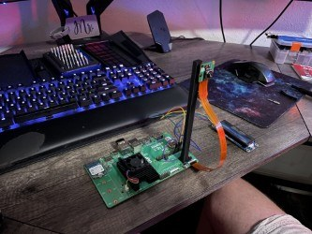
3D Printing
Chassis
  Set up a home 3D printer
  Researched printable Waffle chassis plates
Camera Mount
  Revised the Camera Module 3 bracket
  Taller 170 mm upright, wider base, larger brace
  Printed and mounted the camera
Ethan Bishop

Slide 14
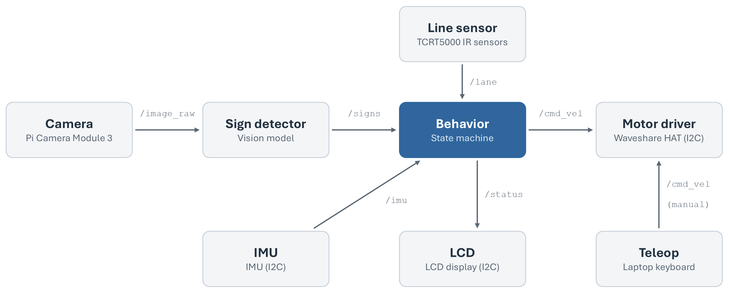
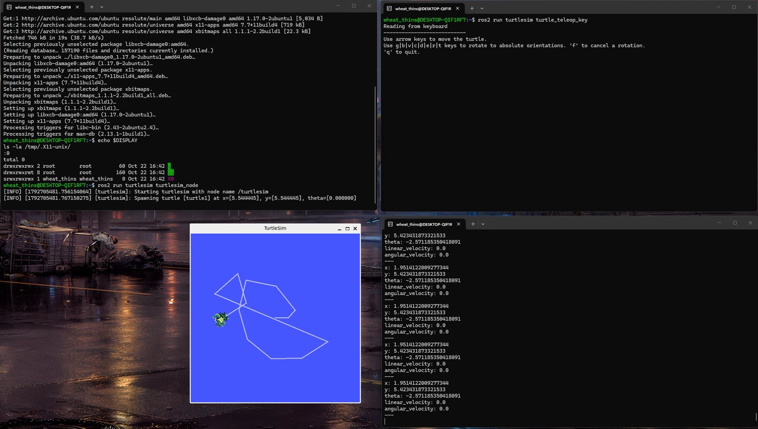
ROS 2 Development
Independent Learning
  Installed ROS 2 under WSL
  Completed the turtlesim tutorial
  Drafted an eight-node architecture
Sign Pipeline
  Camera, sign classifier and LCD nodes
  Runs in Docker on a development machine
  Next: run it on the CM5
Ethan Bishop

Slide 15
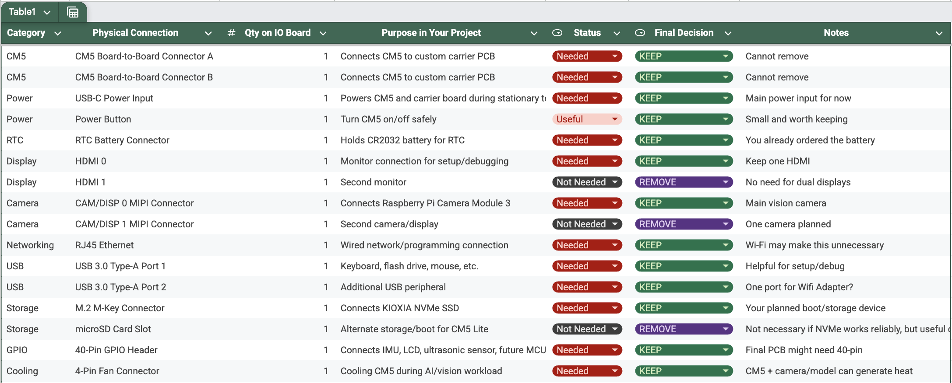
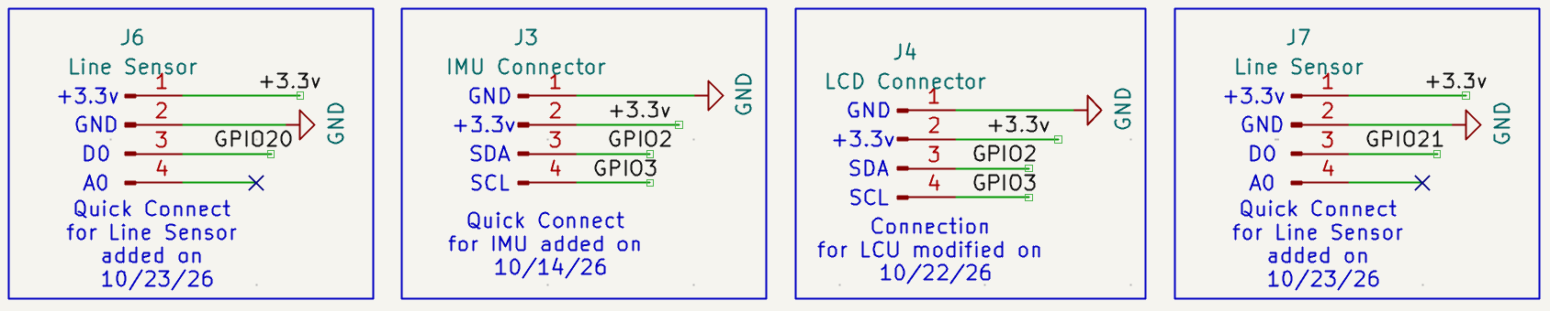
Hardware Planning &
Schematic Modifications
Evaluated Raspberry Pi CM5 IO Board
Identified required hardware connections
Removed unnecessary circuitry
Added LCD, IMU, and sensor interfaces
Abigail Duran

Slide 16
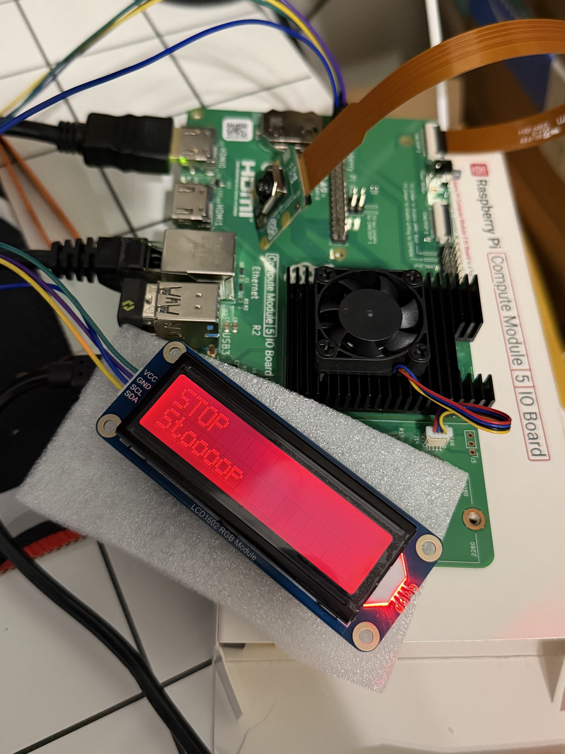
Hardware Testing & Integration
Configured Raspberry Pi Camera Module 3
Established I2C communication with LCD
Developed Python integration script
Simulated road sign predictions and responses
Abigail Duran

Slide 17
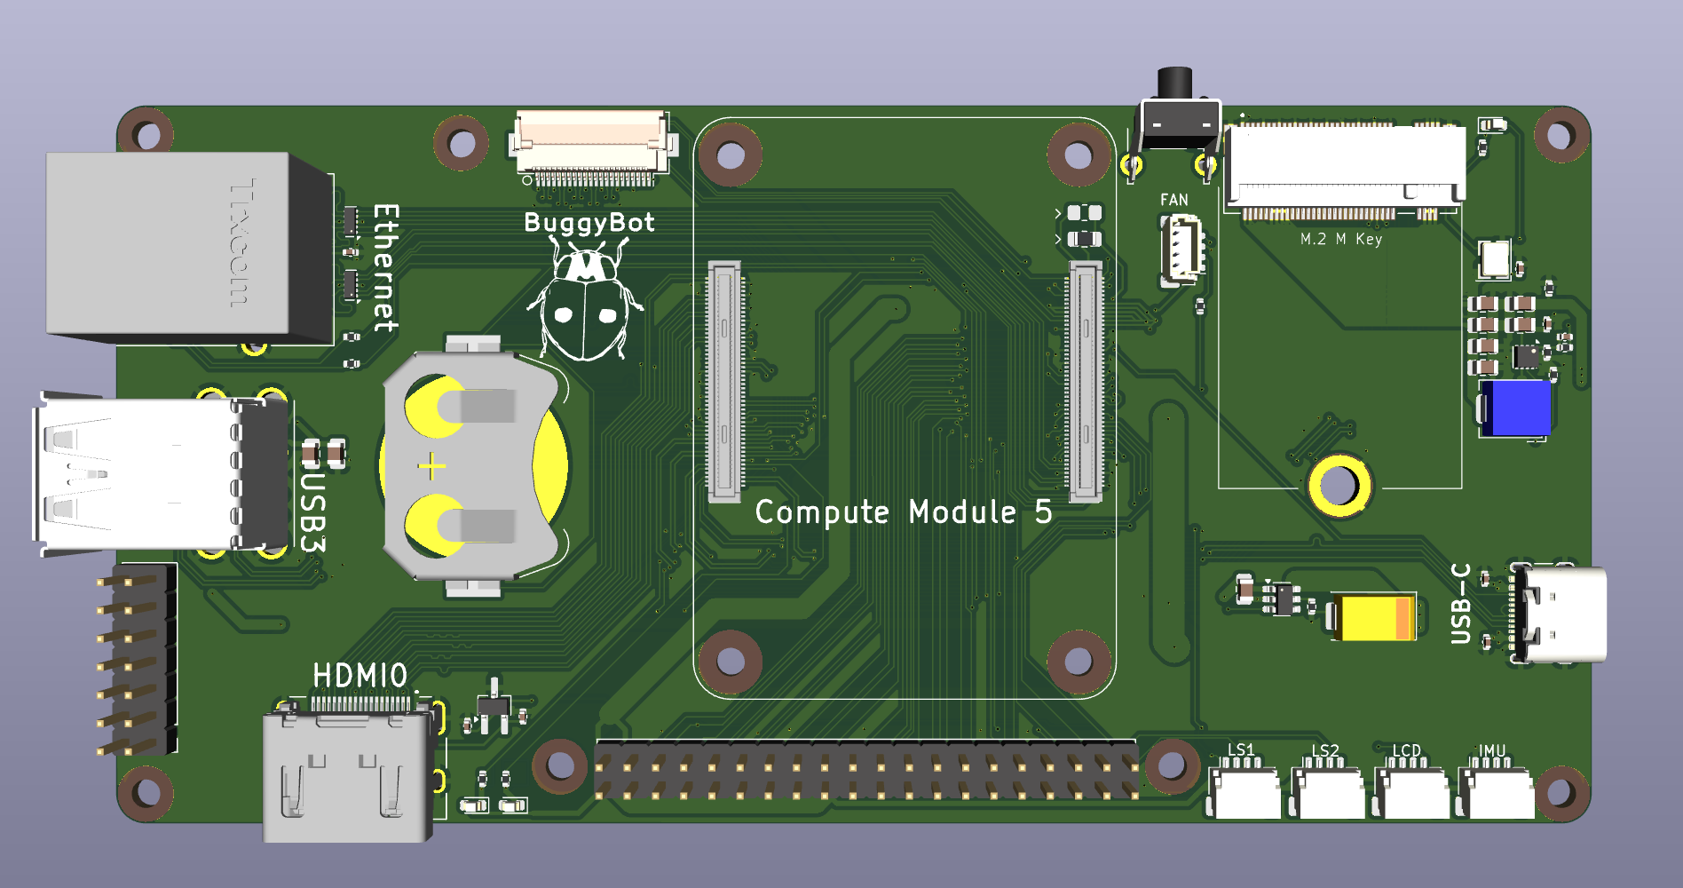
Custom PCB Design & Development
Redesigned CM5 carrier board layout
Optimized component placement
Routed high-speed differential pairs
Implemented power and ground copper zones
Generated manufacturing files
Abigail Duran

Slide 18
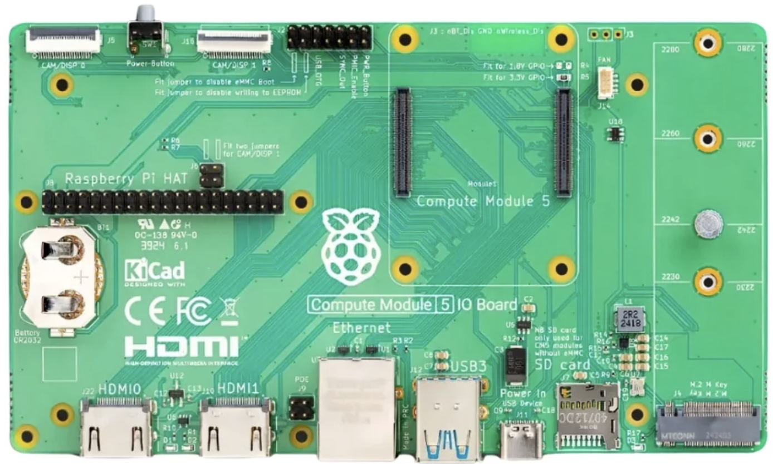
Manufacturing Evaluation & Revised Plan
Manufacturing files submitted to PCBWay
Total manufacturing estimate: $583
Custom PCB not financially feasible
Final decision: Use existing CM5 IO Board
Costs are rounded to the nearest dollar. Final total reflects the applied discount.
Abigail Duran

Slide 19
Cost: Semester 1 Demo
Item | Price
Raspberry Pi CM5 (4 GB, Lite) | $100.00
128 GB NVMe SSD (boot drive) | $44.89
GL.iNet travel router | $39.99
Energizer 20,000 mAh power bank | $29.99
Camera Module 3 | $29.25
CM5 IO Board | $20.00
LCD1602 RGB display | $17.99
Heatsink and fan | $11.99
CR2032 coin cell (clock battery) | $6.29
Camera cable | $2.70
Demo total | $303.09
Everything in the demo, powered by the power bank

Slide 20
Cost: Spent to Date
Category | Includes | Cost
Compute and storage | CM5, IO Board, cooling, SSD + enclosure, coin cell | $201.16
Motors and chassis | Chassis kit, TT motors, motor HATs and driver | $62.86
Power | Two bench supplies, power bank | $59.87
Camera and display | Camera Module 3, camera cable, LCD | $49.94
Networking | Travel router, USB Wi-Fi adapter | $49.98
Sensors and cables | IMU, line and distance sensors, I²C cables | $40.44
Total spent to date |  | $464.25
Custom PCB (not purchased): quoted $583 Itemized in Hardware/partslist.md

Slide 21
Future Work: Semester 2
Goal: drive a course on its own and obey the signs
Vehicle
• 3D-printed chassis
• Choose the motor HAT: Cokoino or Waveshare
• Motor battery and charger
Driving
• Follow the course line with the line sensors
• Use the IMU for heading and turns
• Respond to each detected sign
Software
• Connect sign detection to motor control
• Evaluate ROS 2 on the CM5
Sign model
• Ready for Semester 2
• Tune as needed once it runs on the vehicle

